Slide 1
AI for Dots-and-Boxes
Manish Kumar, Jessica Kunkel
Foundations of AI (Spring 2025)

Slide 2
Overview
Context:
Dots-and-Boxes is a strategic grid-based game where players aim to close more boxes than their opponent.
Ideal environment for experimenting with AI-driven decision-making due to its adversarial and turn-based structure.
Problem Statement:
How can artificial intelligence effectively learn and make decisions in a game with a large move space and strategic depth?
Teaser:
One AI agent plans like a chess master, simulating many future possibilities.
The other learns from experience, evolving smarter over time.
Who wins when Planning vs. Learning go head-to-head?
Notes:
Manish

Slide 3
Context
Dots-and-Boxes is a classic two-player pencil-and-paper game
Players take turns drawing lines between dots in a grid
Whenever a player completes a box, they gain an additional turn
The game ends when the grid is full of completed boxes. The player with the most boxes wins.
The game, while simple in rules, demands complex strategic planning, making it ideal for AI experimentation.
Real-time gameplay and an adversarial setting offer a perfect testbed for studying AI decision-making.
Notes:
Manish

Slide 4
Problem
Develop intelligent AI agents capable of playing Dots and Boxes strategically and competitively.
Compare two different AI approaches:
Monte Carlo Tree Search (MCTS): Uses simulations and tree-based search for tactical play.
Reinforcement Learning (RL): Learns policies through reward feedback over repeated games.
Evaluate how each agent performs in an uncertain, adversarial game environment
Notes:
Manish

Slide 5
Overview of Solution and Contributions
Developed two AI agents to play Dots-and-Boxes using distinct methodologies:
MCTS Agent: Simulates many possible outcomes using a tree-based structure and selects moves with the highest statistical confidence.
Reinforcement Learning Agent: Learns optimal strategies over time by playing numerous games (self-play or MCTS-adversary) and receiving rewards.
Key Contributions:
Designed a rule-based simulation environment supporting real-time play.
Implemented a visual game interface for AI vs AI observation and human vs AI gameplay.
Conducted a comparative evaluation of MCTS vs RL agents:
Overall win rate, win rate as Player 1 vs as Player 2
Provided insights into the strengths of planning (MCTS) vs learning (RL) in strategic game AI.
Notes:
Manish

Slide 6
AI Model(s) – Monte Carlo Tree Search
Approach: Simulates possible future game states using tree expansion and statistical analysis.
Phases: Selection → Expansion → Simulation → Backpropagation
Selection: Traverse the existing tree using the UCB1 formula to balance trying new moves and choosing the best-known ones.
Expansion: Add a new branch to the tree when a move hasn't been tried yet.
Simulation: Play out the game from the new move using random or smart guesses until the end or for a set number of steps.
Backpropagation: Pass the result of the game back up the tree, updating each move with how well it did.
Heuristic: Favors actions likely to complete boxes during rollouts.
Strengths: Strong from the start, no prior training needed, effective in tactical situations.
Notes:
Manish

Slide 7
AI Model(s) – Reinforcement Learning
Approach: Developed using active reinforcement learning principles, learns optimal moves by playing many games and receiving feedback (rewards).
Architecture: Q-network updated over numerous training episodes.
Utilizes Deep-Q learning supplemented by a Convolutional Neural Network to interpret the spatial features of the Dots-and-Boxes board
Developed using PyTorch
Three RL model variations implemented:
Learning through self-play
Learning through gameplay against an MCTS agent using fewer simulations
Learning through gameplay against MCTS with an improved reward scheme
Notes:
Jessica

Slide 8
AI Model(s) – Reinforcement Learning
Learning Signal: +1 for each box closed (point scored)
A secondary learning model utilized the following reward scheme:
+1 for each box closed
-1 for each move that would allow the opponent to score a point
+0.5 for moves that would lead to continued turns
+10 for winning the match
-10 for losing the match
Strengths:
Mimics human learning through experience
RL allows the agent to improve with training over many games, updating its strategy over time to maximize long-term rewards
Notes:
Jessica

Slide 9
AI Model(s) – Reinforcement Learning
Agent | Training | Number of Simulations | Epsilon value
RL Agent-10 | Self-play | 10 | 4.700E-02
RL Agent-100 | Self-play | 100 | 9.973E-05
RL Agent-500 | Self-play | 500 | 9.973E-05
RL Agent-1000 | Self-play | 1000 | 9.973E-05
RL Agent 2.0-10 | MCTS-play | 10 | 2.201E-01
RL Agent 2.0-100 | MCTS-play | 100 | 9.973E-05
RL Agent rewards-10 | MCTS-play with updated reward structure | 10 | 1.981E-01
RL Agent rewards-100 | MCTS-play with updated reward structure | 100 | 9.973E-05
Notes:
Jessica

Slide 10
Monte Carlo Tree Search vs Reinforcement Learning
The MCTS agent was tested against each RL agent
Results were collected for overall performance, performance as Player 1, and performance as Player 2
Statistical analysis was performed using a two-proportion z-test with Holm-Bonferroni correction for multiple tests
Notes:
Jessica

Slide 11
Overall MCTS vs RL Results
Agent | Games Played | Games Won | % Won
MCTS | 800 | 369 | 46.13
RL Agent-10 | 100 | 54 | 54.00
RL Agent-100 | 100 | 76 | 76.00
RL Agent-500 | 100 | 55 | 55.00
RL Agent-1000 | 100 | 47 | 47.00
RL Agent 2.0-10 | 100 | 40 | 40.00
RL Agent 2.0-100 | 100 | 58 | 58.00
RL Agent rewards-10 | 100 | 47 | 47.00
RL Agent rewards-100 | 100 | 54 | 54.00
Notes:
Jessica

Slide 12
Results: Each Agent as Player 1
Agent | Games Played | Games Won | % Won
MCTS | 400 | 177 | 44.25
RL Agent-10 | 50 | 28 | 56.00
RL Agent-100 | 50 | 39 | 78.00
RL Agent-500 | 50 | 30 | 60.00
RL Agent-1000 | 50 | 22 | 44.00
RL Agent 2.0-10 | 50 | 20 | 40.00
RL Agent 2.0-100 | 50 | 26 | 52.00
RL Agent rewards-10 | 50 | 18 | 36.00
RL Agent rewards-100 | 50 | 25 | 50.00
Notes:
Jessica

Slide 13
Results: Each Agent as Player 2
Agent | Games Played | Games Won | % Won
MCTS | 400 | 192 | 48.00
RL Agent-10 | 50 | 26 | 52.00
RL Agent-100 | 50 | 37 | 74.00
RL Agent-500 | 50 | 25 | 50.00
RL Agent-1000 | 50 | 25 | 50.00
RL Agent 2.0-10 | 50 | 20 | 40.00
RL Agent 2.0-100 | 50 | 32 | 64.00
RL Agent rewards-10 | 50 | 29 | 58.00
RL Agent rewards-100 | 50 | 29 | 58.00
Notes:
Jessica

Slide 14
Statistical Analysis
Overall Performance
Before correction, only the RL Agent trained through self-play for 100 episodes (p = 2.10 E-6), showed a significant difference (p > 0.05)
After applying the Holm-Bonferroni correction for 8 comparisons, it held that there was a statistically significant difference between the MCTS win rate and the RL Agent-100 win rate (adjusted threshold = 0.00625)
Differences for all other agents were non-significant (p > adjusted thresholds).
Notes:
Jessica

Slide 15
Statistical Analysis
Player 1 vs Player 2 Performance
Before correction, only the RL Agent trained against an easier MCTS with the updated reward structure for 10 episodes showed a significant difference (p = 0.027); there was no statistically significant difference between the performance of the other AI agents as player 1 and player 2 (p > 0.05).
After applying the Holm-Bonferroni correction for 9 tests, it was found that there was no statistically significant difference between the Player 1 and Player 2 performances of RL Agent Rewards-10 (adjusted threshold = 0.00556).
In summary, no differences between Player 1 and Player 2 performances were statistically significant.
Notes:
Jessica

Slide 16
Discussion
MCTS and RL agents had similar performance in Dots-and-Boxes
Statistical significance of the performance of RL-100 is likely an outlier
RL-500 and RL-1000 have the same epsilon value and similar, if not improved, Q-networks, and did not demonstrate similar performance
Informal Human vs AI gameplay (a dummy comparison playing against MCTS, RL Agent-1000, and RL Agent Rewards-100 was performed briefly) shows the need for improvement in both MCTS and RL models
It’s extremely easy for a human to beat both AI models in Dots-and-Boxes
While each agent is a valid proof of concept, there is definite room for improvement to meet the level of the state of the art in AI gameplaying agents
Notes:
Jessica

Slide 17
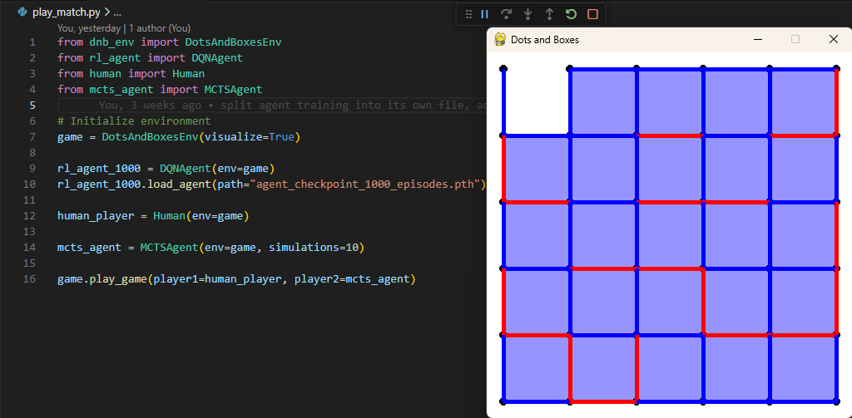
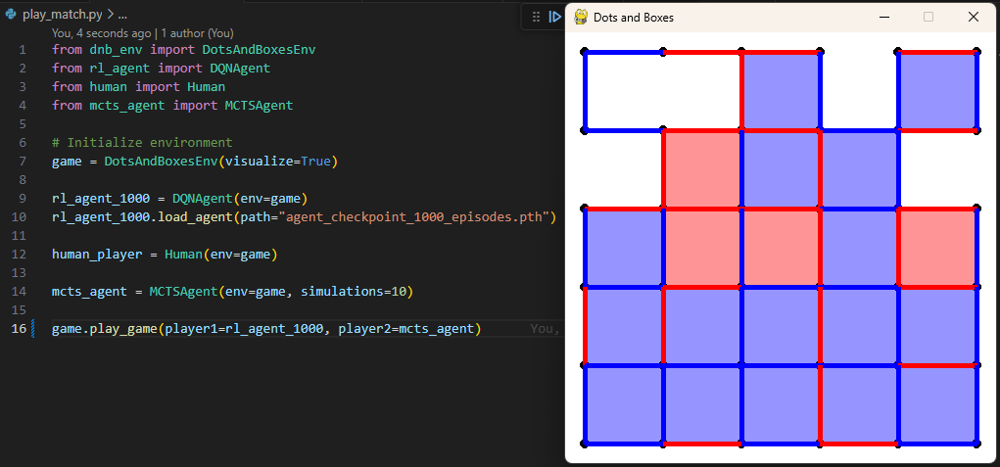
Gameplay Visualization
Notes:
Jessica

Slide 18
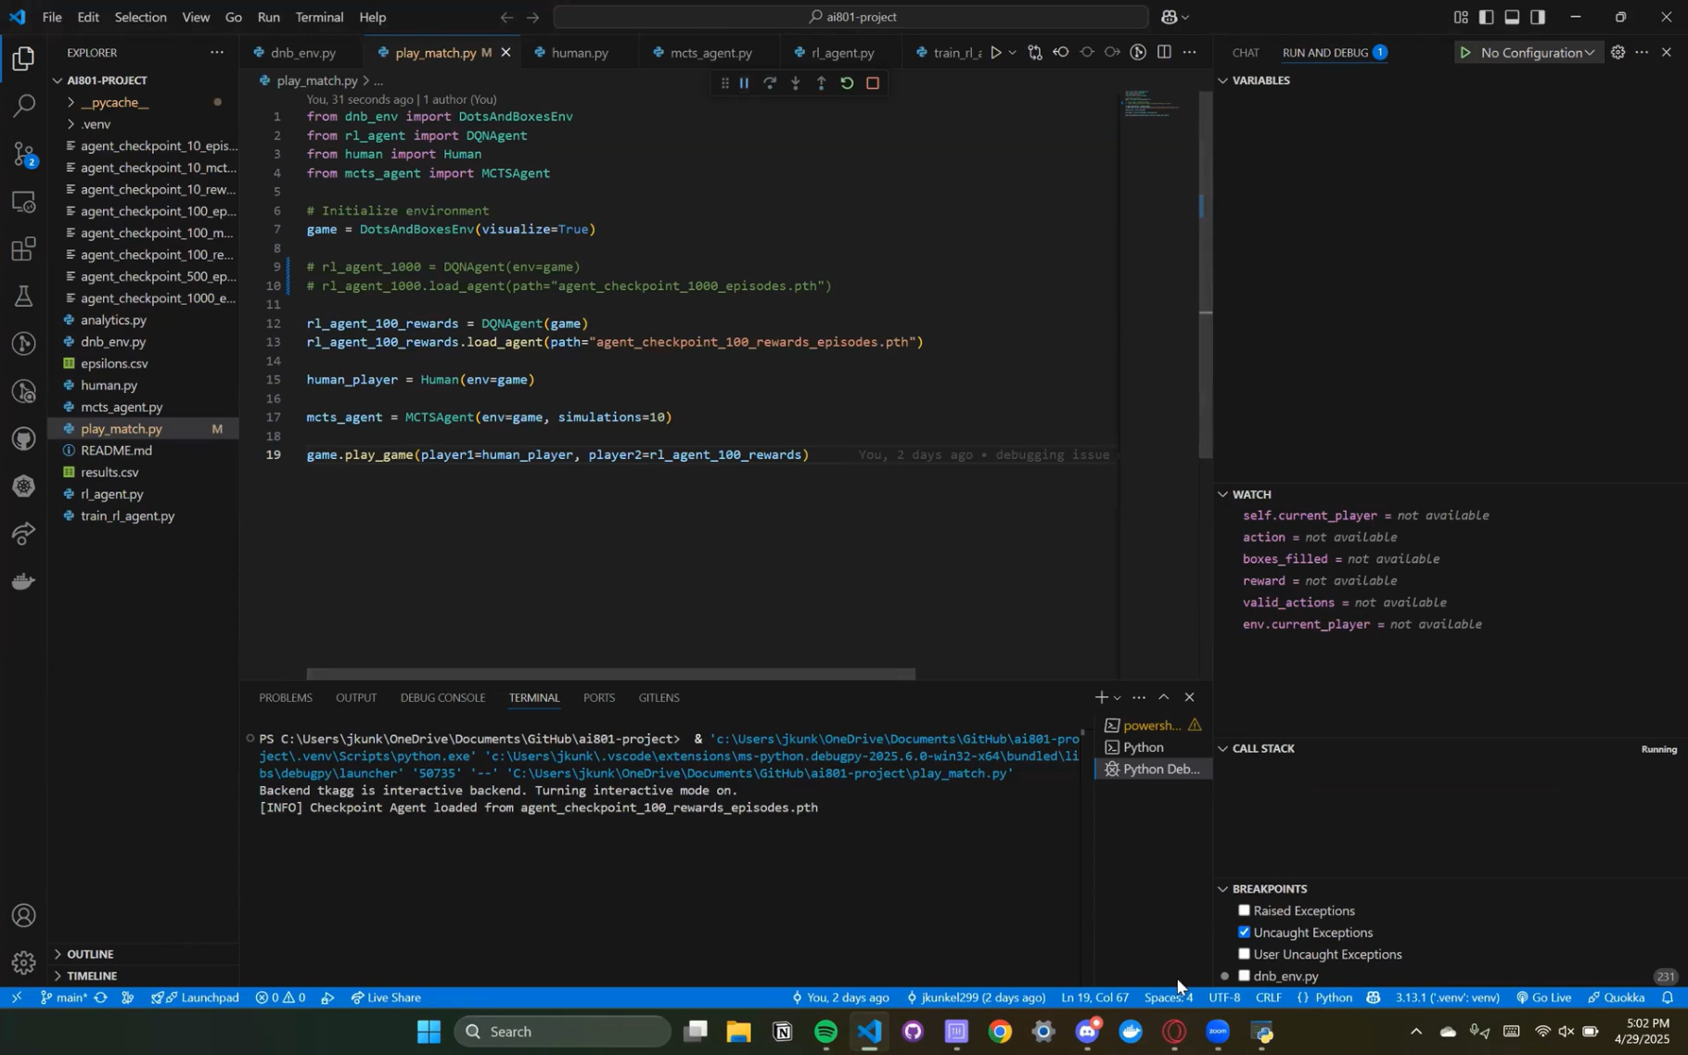
Gameplay Visualization
Notes:
Just hit play vs RL rewards -100

Slide 19
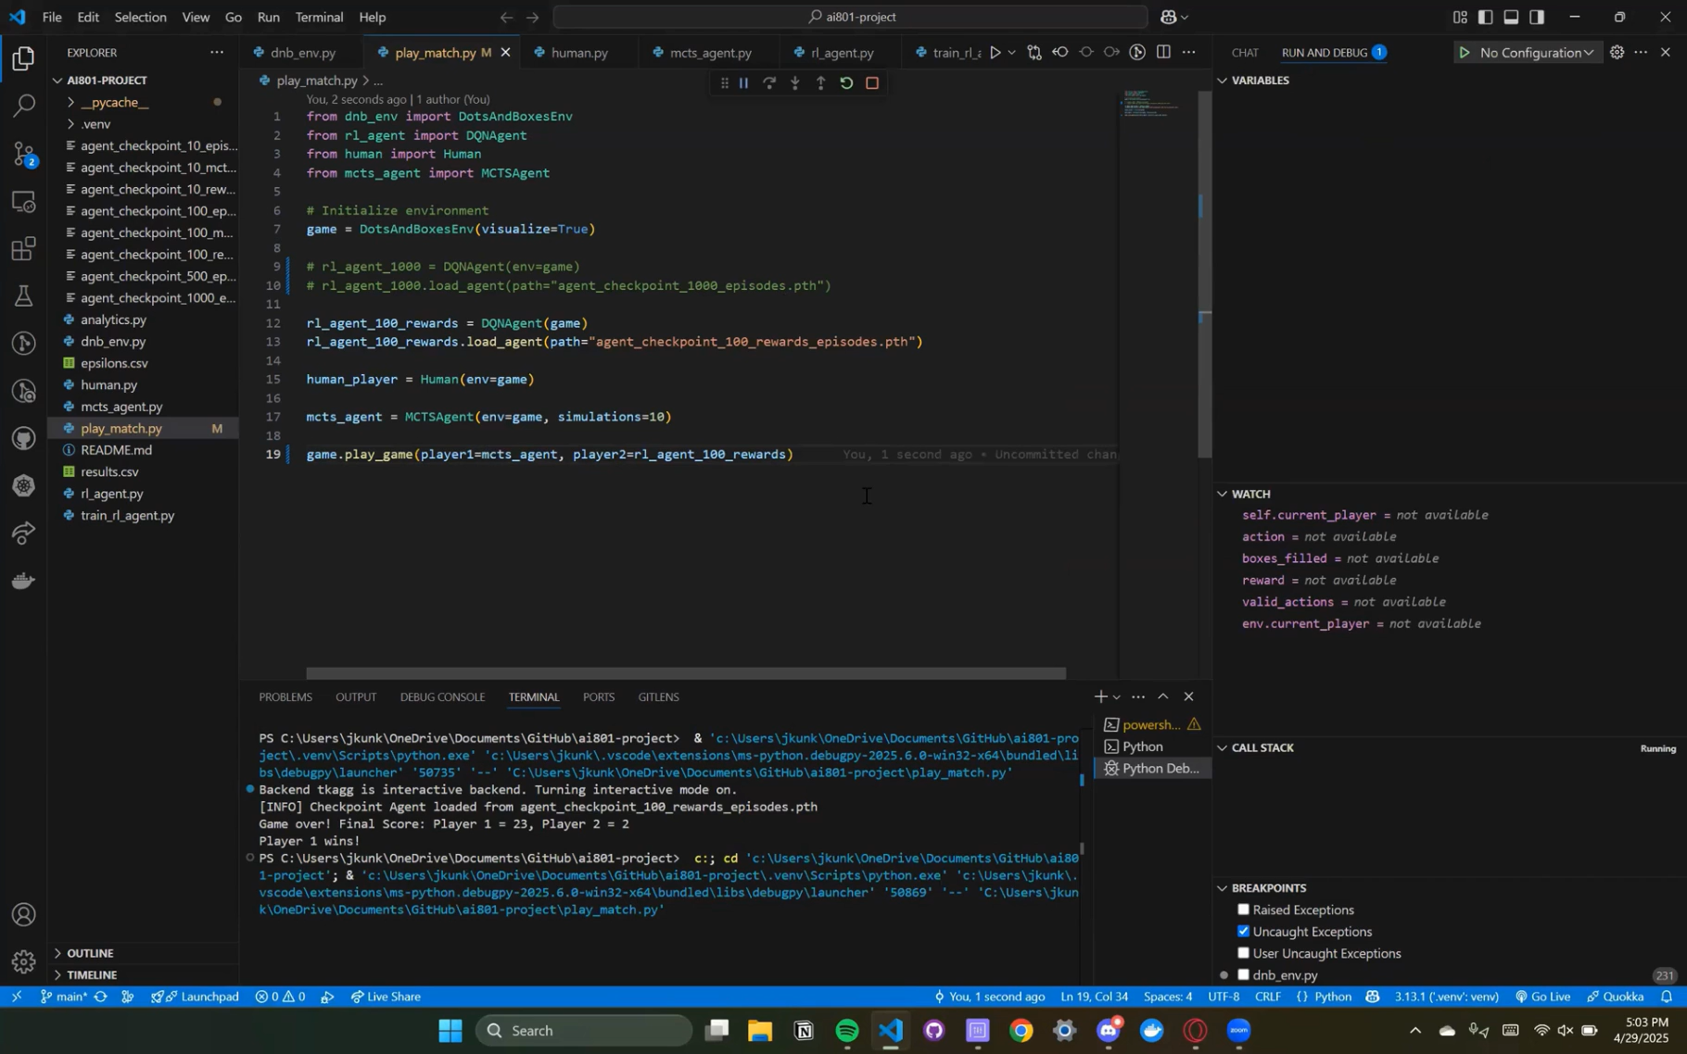
Gameplay Visualization
Notes:
Just hit play

Slide 20
Conclusion
Achievements:
Successfully developed Monte Carlo Tree Search vs Reinforcement Learning and Human vs AI gameplay for Dots-and-Boxes:
MCTS: Strong tactical performance from the start.
RL: Improved performance through learning over time.
Designed a full simulation environment (OpenAI Gym) with visual gameplay (Pygame).
Insights:
Similar performance between MCTS and RL models
Room for improvement in each model for Human gameplay
Game as AI Sandbox: Dots-and-Boxes proved to be an effective platform to explore and compare AI decision-making techniques.
Notes:
Manish

Slide 21
Future Directions
More thorough human vs AI testing
Implement hybrid model that combines MCTS and RL
Applying MCTS and RL techniques to more complex games or real-world problems
Notes:
Manish

Slide 22
References
References:
Dots and Boxes – Wikipedia
Game Rules – UCLA Math Department
AlphaGo & MCTS Research:
Silver D, Huang A, Maddison CJ, et al. “Mastering the game of Go with deep neural networks and tree search.” Nature 529: 484-489 (2016). https://doi.org/10.1038/nature16961
RL Tutorials & OpenAI Gym documentation – https://gymnasium.farama.org
Zhuang Y, Li S, Peters TV, Zhuang C. “Improving Monte-Carlo Tree Search for Dots-and-Boxes with a novel board representation and artificial neural networks.” 2015 IEEE Conference on Computational Intelligence and Games (CIG), Tainan, Taiwan: 314-321 (2015). https://doi.org/10.1109/CIG.2015.7317912.
GitHub - jkunkel299/ai801-project: Dots and Boxes game with AI players

Slide 23
Thank you!

